Slide 3
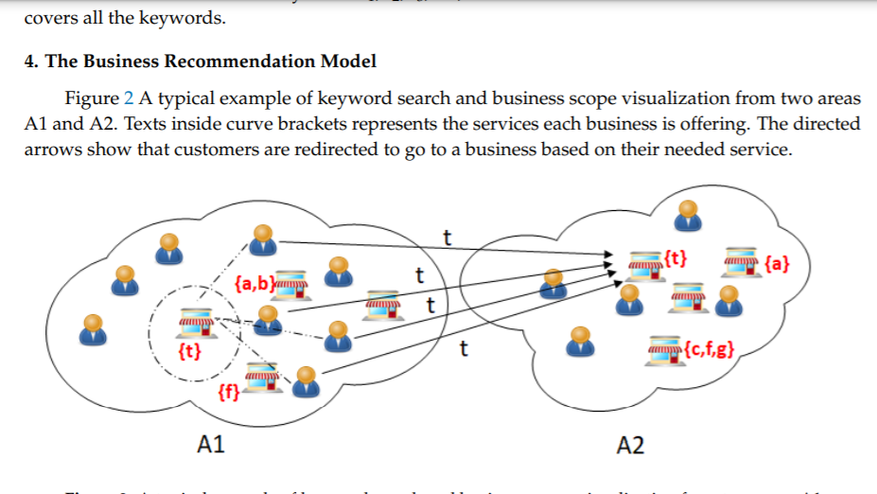
Location Based Business Recommendation Using Spatial Demand
Great use for enterprenures to get a perfect
area and number of customers who
need for the service .
Predicting the match winner
https://blog.coast.ai/this-is-how-i-used-machine-learning-to-accuratel
y-predict-villanova-to-win-the-2016-march-madness-ba5c074f1583#.e6xllp64p
Madhurika Ganiger

Slide 4
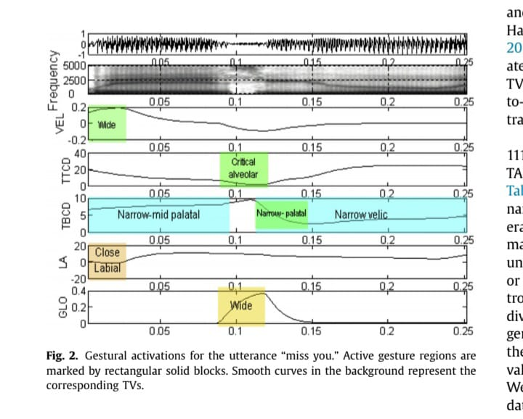
A deep Convolutional neural network approach for static hand gesture recognition
https://www.sciencedirect.com/science/article/pii/S1877050920312473/pdf?md5=a4c07e371bbe5d4c4e0d663491bfd2da&pid=1-s2.0-S1877050920312473-main.pdf
Hybrid CNN for articulatory and acoustic based speech
recognition
https://cpb-us-e1.wpmucdn.com/blog.um
d.edu/dist/c/619/files/2019/11/journal_vikram_2017.pdf
Sakshi T

Slide 5
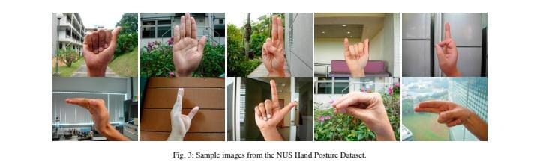
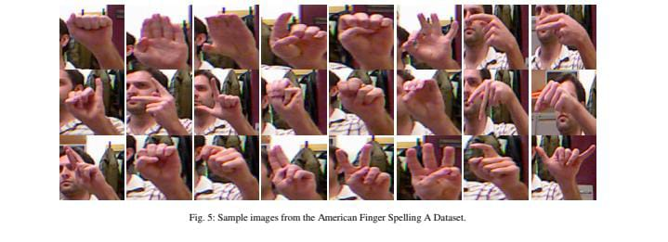
Hand Gesture Classification basef on nonaudible Sound using CNN
https://www.hindawi.com/journals/js/2019/1084841/
Neural integration of speech and message
https://journals.plos.org/plosone/article?id=10.1371/journal.pone.0069173

Slide 6
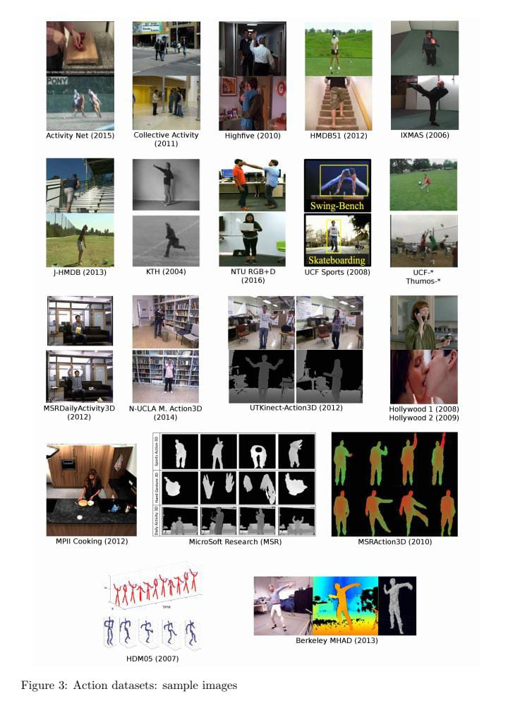
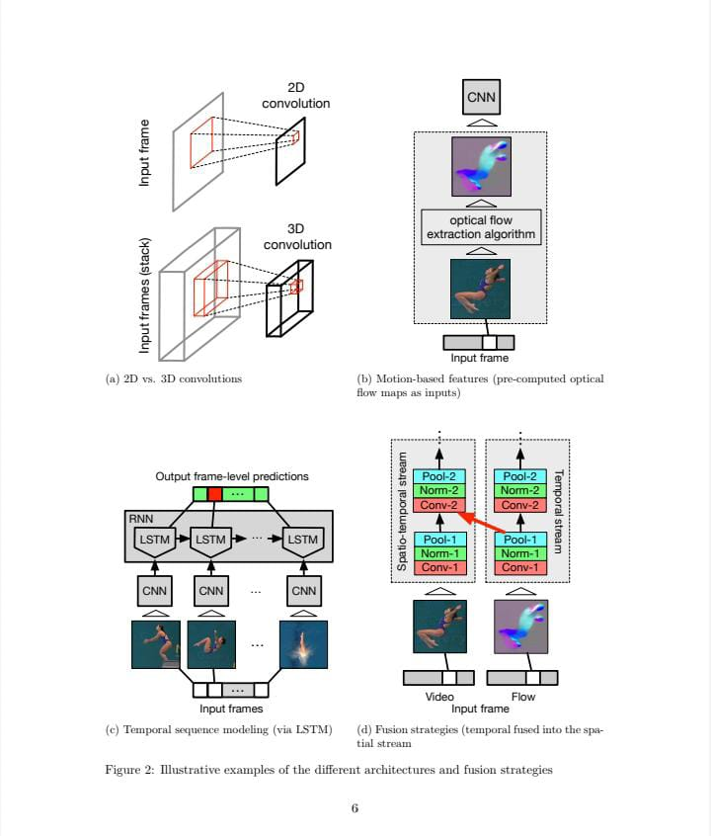
Deep learning for action and gesture recognition in image sequence
https://hal.inria.fr/hal-01678006/document
Sakshi T

Slide 7
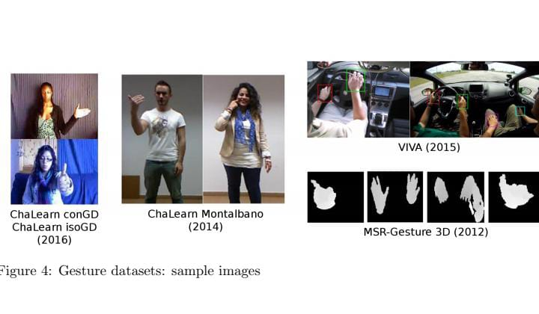
continued..
..

Slide 8
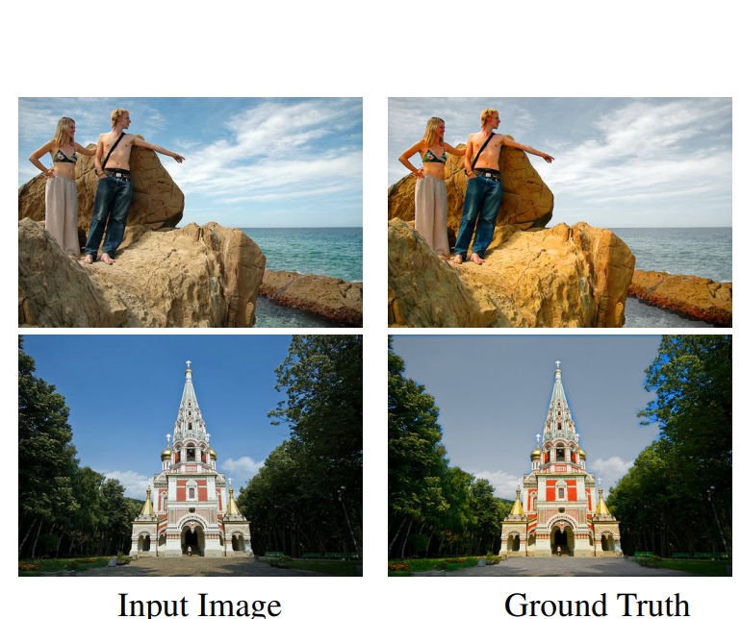
AUTOMATIC IMAGE STYLIZATION USING DEEP FULLY CONVOLUTIONAL NETWORKS : Conventional automatic photo adjustment has difficulty in representing complex color transforms between images before and after adjustment. Most of them merely model global color transforms without considering local semantic contexts. Aim : Given a set of exemplar image pairs, each representing a photo before and after pixel-level color and tone adjustments following a particular style, we wish to learn a computational model that can automatically adjust a novel input photo in the same style.
Abhishek rao

